Slide 1



.
CS 112 – Foundations of
Computer Science
Dr. Adriano Cavalcanti
PhD MABE, MS EE, BSc CSc
Computational Nanotechnology & Biomed Robotics
Office location: Hebeler 107 - Phone 509-963-2063
Email: adriano.cavalcanti@cwu.edu
Office hours:
Mon Tue Wed 2:00pm-3:00pm; Or by appointment

Slide 2






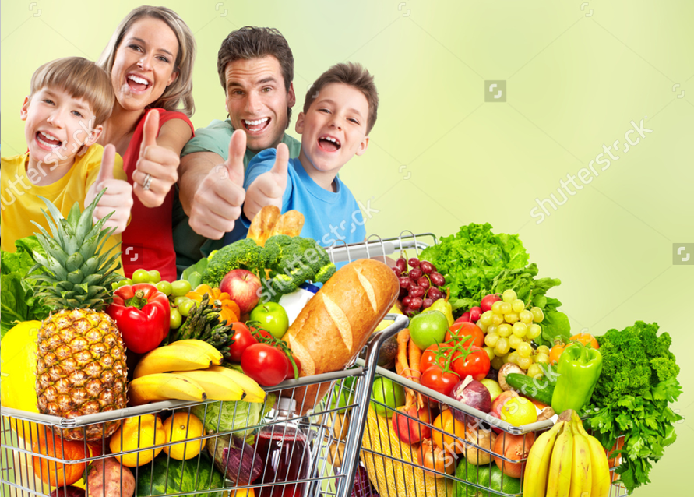
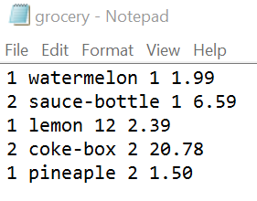

FINAL TASK
Team of two students

Slide 3

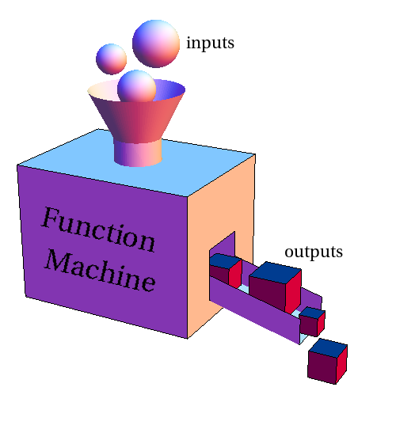


FINAL TASK
1. Create a program with the following features:
API
read_file
ask_receipt_format
calculate_total
print_bill
Notes:
3

Slide 4

FINAL TASK
Write a program comprising the following features:
Read the content from the file named grocery.txt transferring the information to struct data named product. (2points)
The program is comprised by the functions: API, read_file, ask_receipt_format, calculate_total, print_bill. (2points)
The information in the file grocery.txt comprises the grocery list from a customer, having the fields that will comprise the struct data: category, name of the product, quantity purchased, price per unit. (2points)
Ask the user if he wants a receipt printed by price, or by category, or by alphabetical order. (2points)
Print the receipt with the total to be paid, and subtotal per item into the file output_bill.txt. (2points)

Slide 5

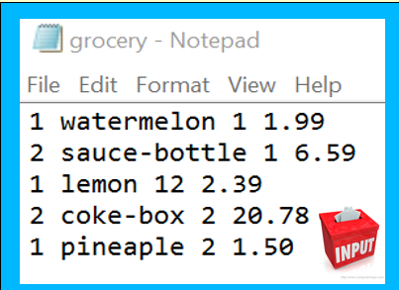

FINAL TASK
Receipt by category
C Name Q Price Sub-Total
1 pineapple 2 1.50 3.00
1 watermelon 1 1.99 3.98
your list is comprised by 2 types of products on category 1
2 coke-box 2 20.78 41.56
2 sauce-bottle 10 6.59 65.99
your list is comprised by 2 types of products on category 2
Bill total: 114.53
C: Category
Q: Quantity

Slide 6


Dr Cavalcanti
a/k/a Dr. Color Candy or Dr. C

